Slide 1
Computer System
BY:- Piragenth

Slide 2
What is Computer System ?
A computer system is a complete setup consisting of input devices, processing units, memory, storage, output devices, and software, all working together to solve problems and automate tasks. The system includes physical components (hardware) and logical instructions (software) that communicate to perform desired functions. Whether it's a desktop computer, laptop, or smartphone, all are examples of computer systems that take in data, process it, and generate output for the user.

Slide 3
Components of a Computer System.
The main components of a computer system include hardware, software, data, and users. Hardware refers to the physical parts like the CPU, keyboard, and monitor. Software includes operating systems and applications that tell the hardware how to operate. Data consists of raw facts and figures that are processed into meaningful information. The user is the person who provides input and receives output. All these components must work together for the system to function effectively.

Slide 4
Basic Hardware Components
Basic hardware components include devices responsible for input, processing, storage, and output. Input devices like keyboards and mice allow users to interact with the system. The central processing unit (CPU) performs calculations and executes instructions. Memory components like RAM temporarily store data during processing, while storage devices such as hard drives or SSDs keep data permanently. Output devices like monitors and printers display or deliver the processed results to the user. Each component plays a key role in the functionality of the system.

Slide 5
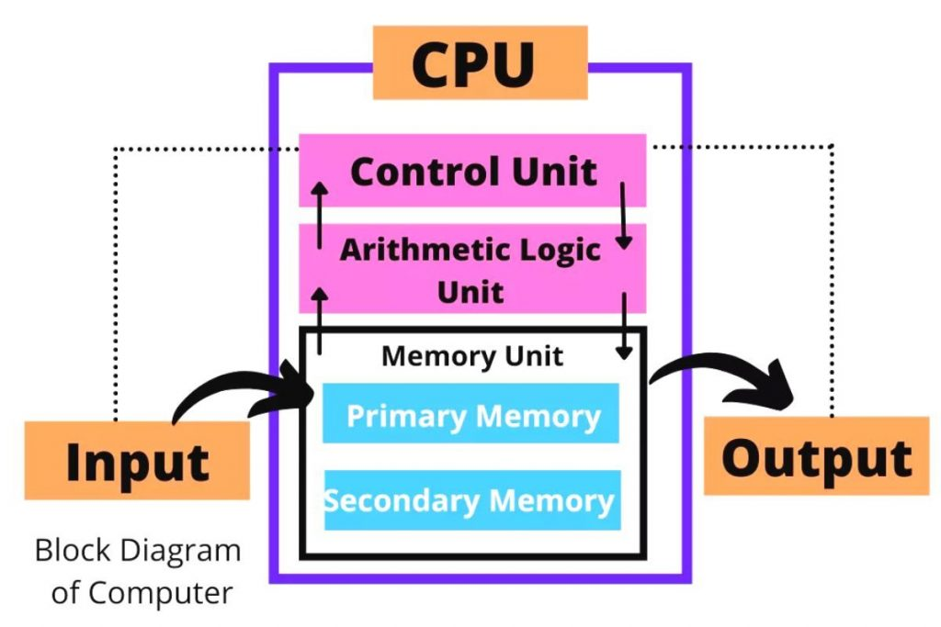
Block Diagram of a Computer System
The block diagram of a computer system visually represents how data flows through the system’s main components. It typically includes four main units: the input unit, processing unit (CPU), memory/storage, and output unit. Data first enters the system through input devices, then the CPU processes it using its Arithmetic Logic Unit (ALU) and Control Unit (CU). The processed data may be stored in memory or sent directly to the output unit.

Slide 6
Thank You

